Slide 1
MARCH 2023
Myob Advanced BUSINESS
VERSION 2022.1
new features
DIANNE SEMMENS
Managing Director
MYOB Exo & Advanced
Notes:
Di to do introduction

Slide 2
MYOB ADVANCED BUSINESS
Release 2022.1
58 improvements and new features
CRM: SELECTION OF EMPLOYEES AS CASE CONTACTS
Finance: Bank reconciliation improvements
MANUFACTURING: Control point operations in production routing
SALES ORDER: NEW FEATURE – BLANKET SALES ORDER
PROJECTS: PROJECT BILLING BASED ON QUANTITY
Notes:
Of the 58 new features in the 2022.1 upgrade - I will touch on only 5 of them
You can read further and in depth about all of these new features in the MYOB Advance Release notes.
The release notes video I have taken the screen shots from is here
https://www.youtube.com/watch?v=23Zqs_zHxH8&t=64s

Slide 3
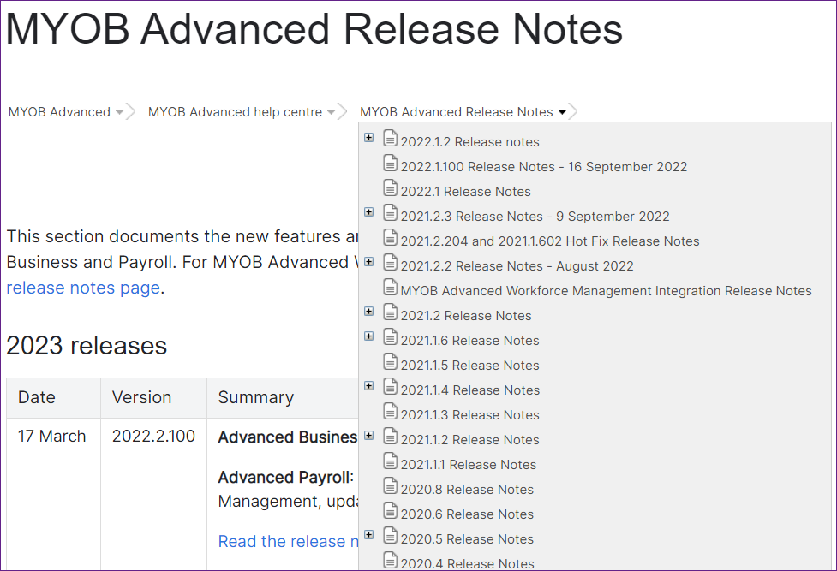
MYOB Advanced release notes available from the
myob help centre
https://help.myob.com/wiki/display/adv
2022.1 Release Notes:
https://help.myob.com/wiki/display/adv/2022.1+Release+Notes?preview=/90636626/95455973/MYOB%20Advanced%202022.1%20Release%20Notes.pdf
Disclaimer: The information presented is generic in nature and may not refer to an individual’s specific requirements.
If you have specific queries, please contact Acacia Consulting Services to speak with a certified Advanced consultant.
Notes:
Release Notes 195 pages
Download them from the Acacia Web site
Or the MYOB Help centre
https://help.myob.com/wiki/display/adv/2022.1+Release+Notes?preview=/90636626/95455973/MYOB%20Advanced%202022.1%20Release%20Notes.pdf

Slide 4
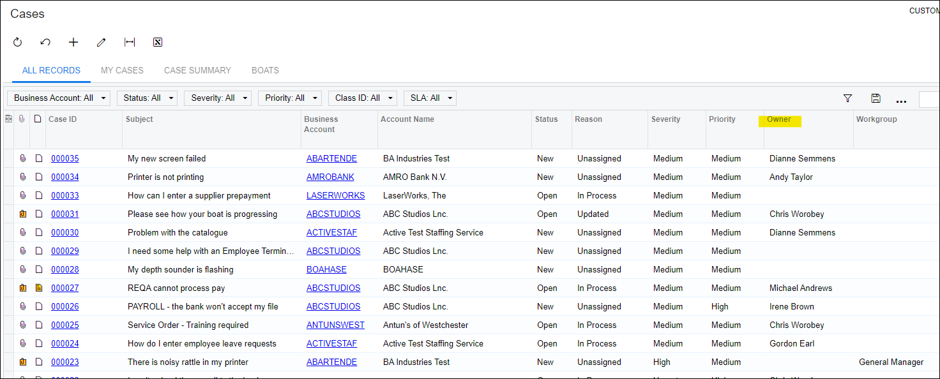
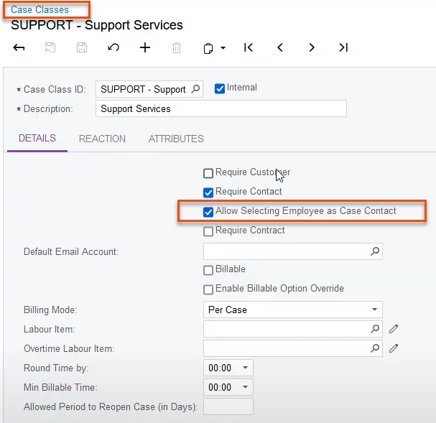
CRM: selection of employees as case contacts
Disclaimer: The information presented is generic in nature and may not refer to an individual’s specific requirements.
If you have specific queries, please contact Acacia Consulting Services to speak with a certified Advanced consultant.
Notes:
A user who is reporting a case on the Cases (CR306000) form can select an employee of the user's own organisation as the case contact, in addition to being able to select a case contact of a business account.
This gives users of MYOB Advanced the ability to submit cases to their organisation's internal IT or legal team. Users can select their own employee accounts as the case contacts

Slide 5
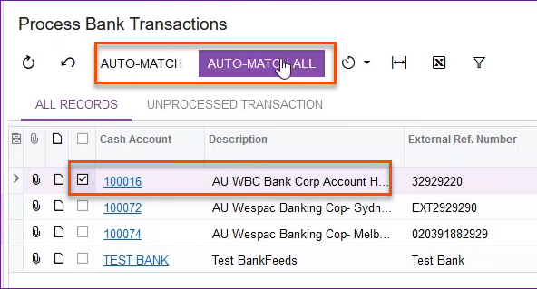
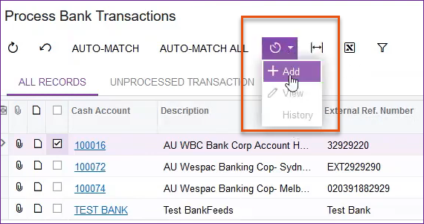
Bank Rec: mass processing of bank transactions
New Screen:
CA50100
Disclaimer: The information presented is generic in nature and may not refer to an individual’s specific requirements.
If you have specific queries, please contact Acacia Consulting Services to speak with a certified Advanced consultant.
Notes:
The Process Bank Transactions (CA3060PL) form has been replaced with the Process Bank Transactions (CA501000) form,
The new form contains the new toolbar:
• Auto-Match: Initiates the process of matching bank transactions for the cash accounts selected in the table
• Auto-Match All: Initiates the process of matching bank transactions for all cash accounts in the table
The results of the matching are saved automatically and need to be processed by the user manually on the Process Bank Transactions (CA306000), as was the case before.
Users can now schedule the automated processing of bank transactions on this form by using automated schedules.
A user can initiate the scheduling process from the Process Bank Transactions (CA501000) form by clicking Schedules > Add on the form toolbar (Item 3), or from the Automation Schedules (SM205020) form.
Talk to use about many processes in Advanced that can be automated.

Slide 6
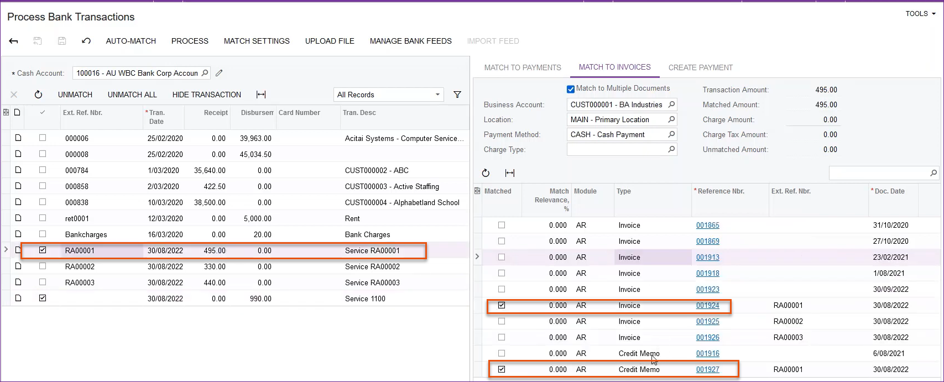
BANK REC: MATCHING OF BANK TRANSACTIONS
TO MULTIPLE AR AND AP DOCUMENTS
New Screen CA306000
Disclaimer: The information presented is generic in nature and may not refer to an individual’s specific requirements.
If you have specific queries, please contact Acacia Consulting Services to speak with a certified Advanced consultant.
Notes:
Also in the Process Bank Transactions (CA306000) form,
Bank transactions can be matched to multiple AR documents (invoices and credit memos) and multiple AP documents (bills and debit adjustments) on the Match to Invoices tab of the Process Bank Transactions (CA306000) form.

Slide 7
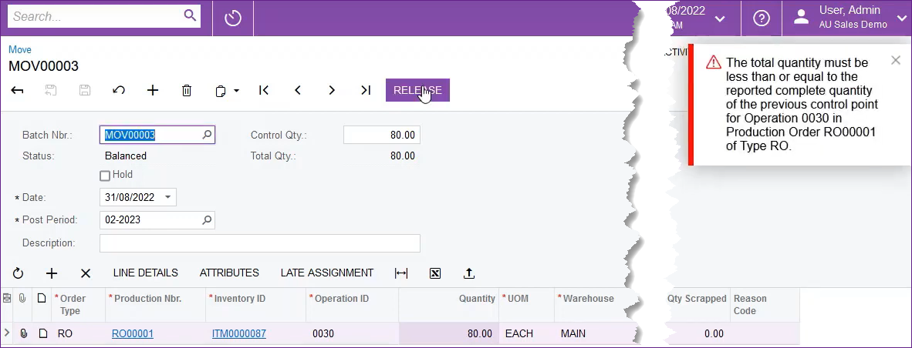
MANUFACTURING:
control point operations in production routing
Disclaimer: The information presented is generic in nature and may not refer to an individual’s specific requirements.
If you have specific queries, please contact Acacia Consulting Services to speak with a certified Advanced consultant.
Notes:
Enhanced recording of quantities of completed items for production operations.
During the production process, there may be specific milestone operations at which workers must record the quantity of completed items.
Now production managers can mark particular routing operations as control points, which means that workers must record the quantity of completed items for each of these operations.
The use of control points provides the following enhancements in the production management process:

Slide 8
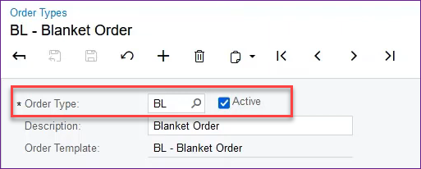
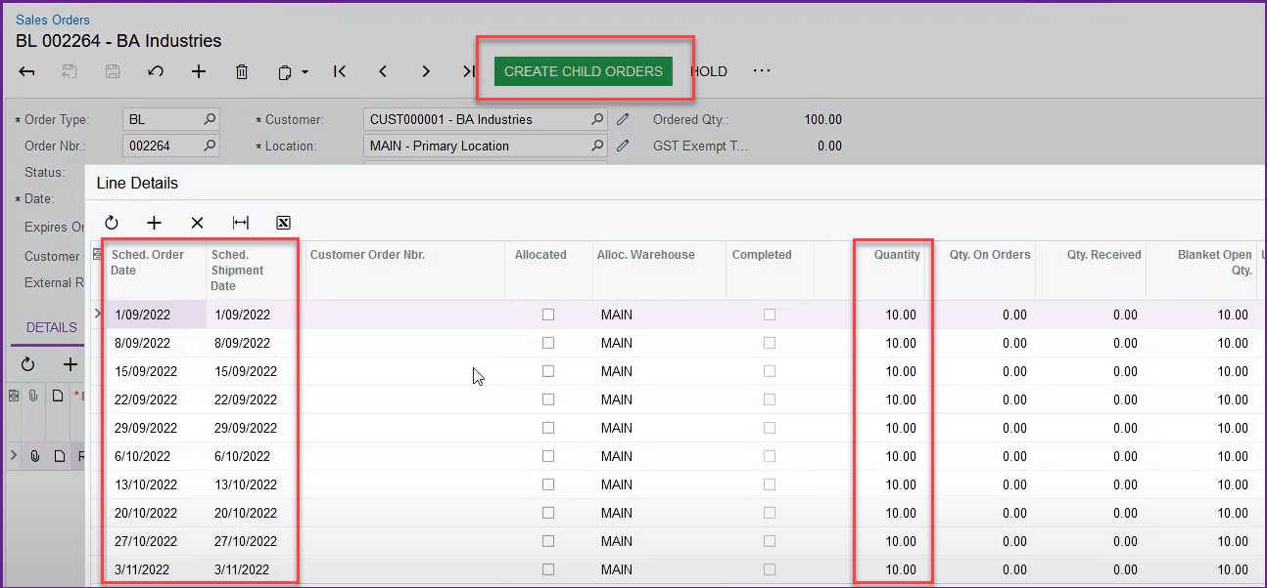
Sales order:
nEW FEATURE – BLANKET sales order
Disclaimer: The information presented is generic in nature and may not refer to an individual’s specific requirements.
If you have specific queries, please contact Acacia Consulting Services to speak with a certified Advanced consultant.
Notes:
Introduces the ability to create blanket sales orders for regular sales based on a long-term agreement between the selling company and the customer.
The blanket sales order functionality is available when the Inventory and Order Management feature is enabled.
Example of entry of large sales order for customer locations over a specified period. T
Schedule Order and Shipment Dates and Qty.
Lines of the blanket sales order are converted to child orders on the date you specify for shipping.
A child order is a regular sales order with a link to the blanket sales order; the child order has an order type with the Sales Order automation behaviour.
The blanket sales order is completed when all child orders have been shipped.

Slide 9
ProjectS: Project billing based on Quantity
Disclaimer: The information presented is generic in nature and may not refer to an individual’s specific requirements.
If you have specific queries, please contact Acacia Consulting Services to speak with a certified Advanced consultant.
Notes:
On the Project Quotes (PM304500) form, a user now can change the business account, location, and contact in any project quote (primary or non-primary) that is assigned the Draft status,
With this functionality, the user can create project quotes for multiple customers and link these project quotes to the same opportunity
Project billing based on quantity
In previous versions of MYOB Advanced, the projects billed by progress could be billed only based on the amount in the revenue budget lines. In MYOB Advanced 2022.1, the functionality of progress billing has been extended. Now a project manager can configure a project so that the pro forma invoices or accounts receivable invoices will be prepared based on the pending quantities specified in revenue budget lines

Slide 10
Q&a
OVER TO YOU

Slide 11
THANK YOU FOR JOINING US
Next water cooler: 24th May
Topic: MYOB Advanced Payroll
SEND THROUGH YOUR MYOB advanced TOPIC IDEAS
PLEASE SEND IDEAS TO HELPDESK@ACACIACS.COM.AU
Notes:
Remember to let other MYOB Advanced users know about Acacia Client Water Coolers.
We will be giving brief over views of new features in Payroll
But we welcome any suggest for other topics to cover

