Slide 1
MAY 2023
Myob Advanced PAYROLL
VERSION 2022.1
new features
LOUISE MULQUEEN
TONYA SEY
Senior Solutions Consultant
MYOB Advanced
Senior Payroll Consultant
MYOB Exo & Advanced
Notes:
Idea for the Water coolers – is to give you a brief update of whats been happening in the software
The presentation is recorded and is available from the Acacia Website under Support \ Water cooler

Slide 2
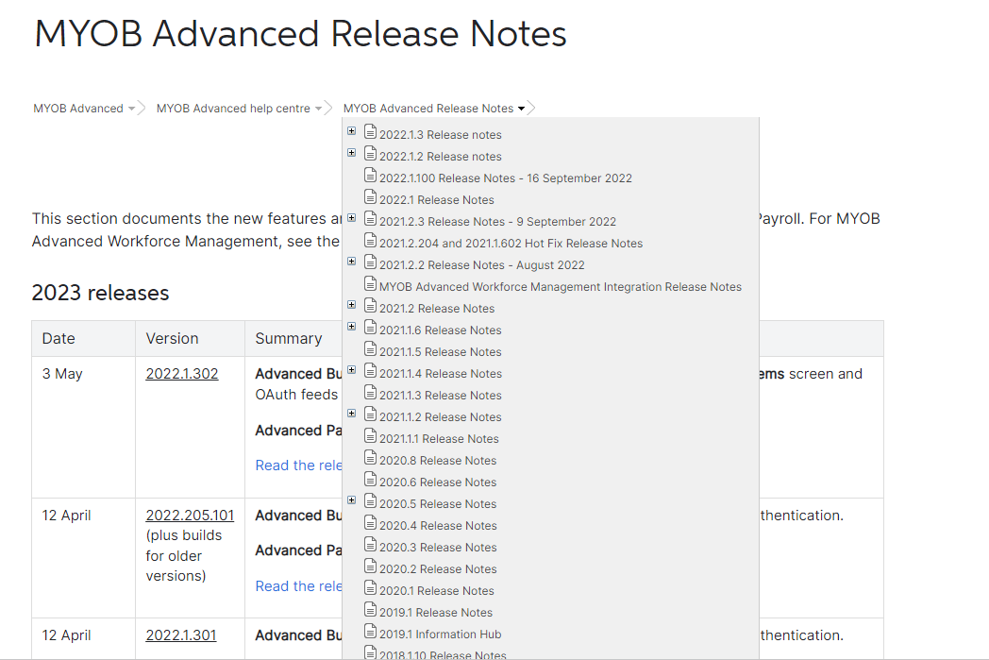
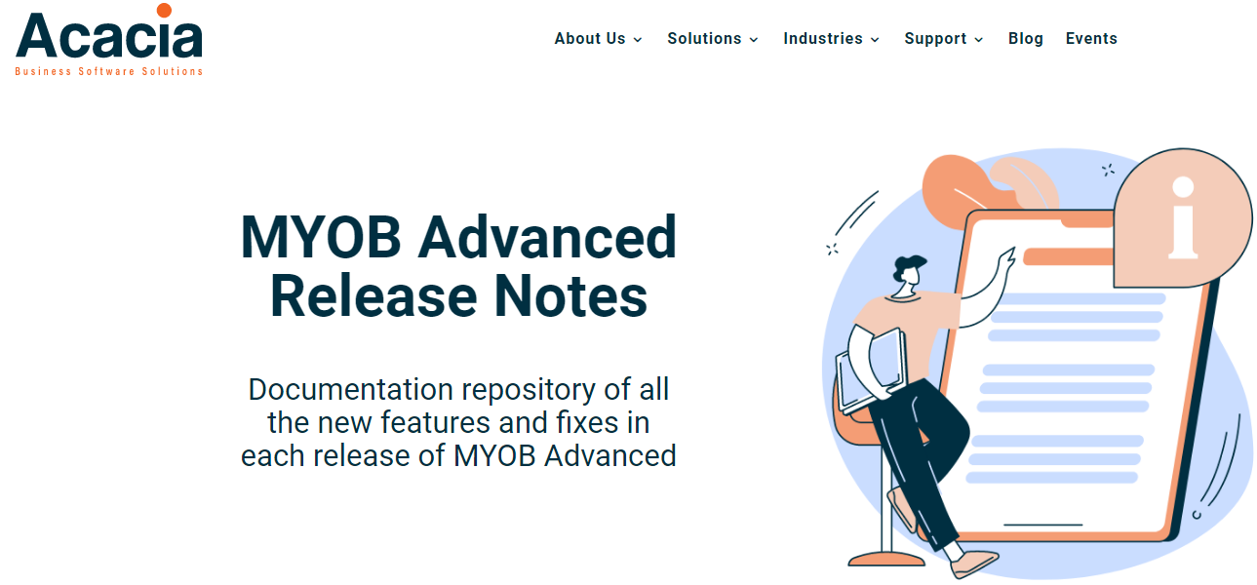
MYOB Advanced release notes
available from the myob help centre
And the Acacia WWW
https://acaciacs.com.au/myob-advanced/myob-advanced-release-notes/
https://help.myob.com/wiki/display/adv
Disclaimer: The information presented is generic in nature and may not refer to an individual’s specific requirements.
If you have specific queries, please contact Acacia Consulting Services to speak with a certified Advanced consultant.
Notes:
Release Notes 195 pages
Download them from the Acacia Web site
Or the MYOB Help centre
https://help.myob.com/wiki/display/adv/2022.1+Release+Notes?preview=/90636626/95455973/MYOB%20Advanced%202022.1%20Release%20Notes.pdf

Slide 3
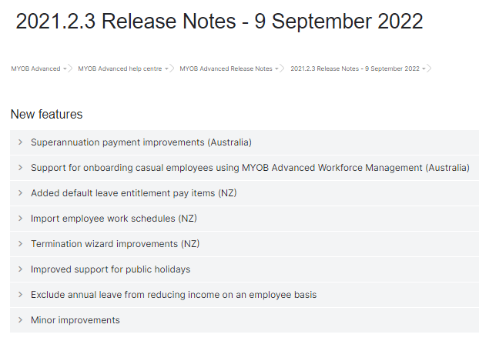
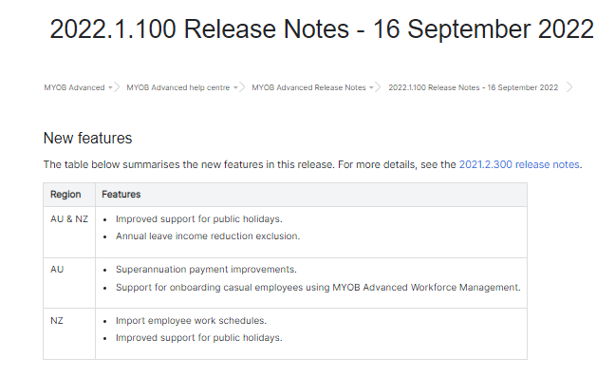
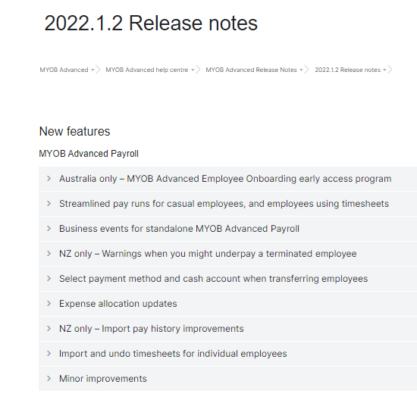
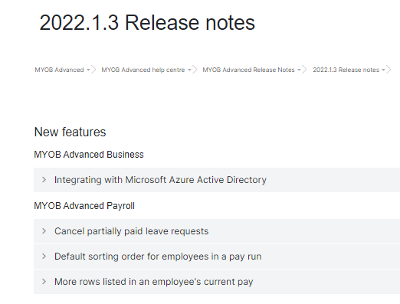
MYOB ADVANCED PAYROLL
Multiple Releases since Sept 2022
improvements and new features
2021.2.3 - 9th September 2022
2022.1.100 - 16th SEPTEMBER 2022
2022.1.2 - 7th DEcember 2022
2022.2.1 & 3 – Feb – March 2023
Notes:
Of the 58 new features in the 2022.1 upgrade - I will touch on only some of them
You can read further and in depth about all of these new features in the MYOB Advance Release notes.

Slide 4
MYOB ADVANCED PAYROLL
improvements and new features
SORT ORDER IN PAY RUN: Default sort order of employees in a pay run
EMPLOYEE SELF SERVICE LEave Requests: cancel partially paid leave requests
Time Sheet importing: Import and undo individual timesheets
Streamline pay runs: for Casual employees and employees using time sheets.
2FA: MANDATORY TRANSITION TO 2FA AUTHENTICATION
LOG ON: SINGLE SIGN ON WITH AZURE ACTIVE DIRECTORY
NEW MODULE: Employee Onboarding
Notes:
Of the 58 new features in the 2022.1 upgrade - I will touch on only some of them
You can read further and in depth about all of these new features in the MYOB Advance Release notes.

Slide 5
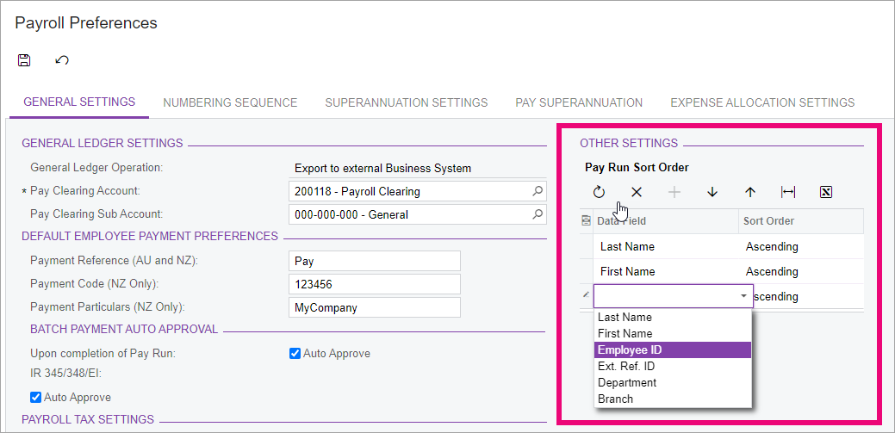
SORT ORDER: Default sort order
Effective in Screens: Pay Run MPPP3120 & Employee Current Pay MPPP3130
To choose the default order,
use the Pay Run Sort Order table on the General Settings tab
of the Payroll Preferences form (MPPP1100).
Disclaimer: The information presented is generic in nature and may not refer to an individual’s specific requirements.
If you have specific queries, please contact Acacia Consulting Services to speak with a certified Advanced consultant.
Notes:
New setting allows you to setup the Sort order for the employees in a Pay run in the Pay Run Details Screen.
Also the
To choose the default order, use the Pay Run Sort Order table on the General Settings tab of the Payroll Preferences form (MPPP1100).

Slide 6
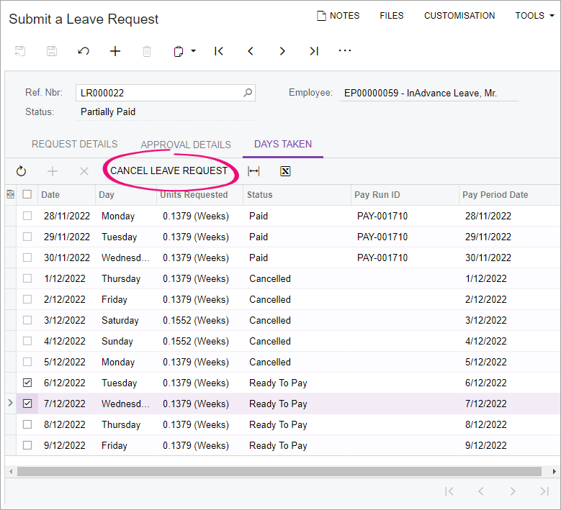
ESS LEAVE REQUESTS: CANCEL PARTIALLY PAID LEAVE REQUESTS
You can now cancel partially paid leave requests.
Cancelling leave requests is available both for employees and administrators who can submit leave on behalf of employees.
The cancelled leave is seen in the Leave Administration screen
Disclaimer: The information presented is generic in nature and may not refer to an individual’s specific requirements.
If you have specific queries, please contact Acacia Consulting Services to speak with a certified Advanced consultant.
Notes:
You can now cancel partially paid leave requests, letting you more flexibly manage leave that spans multiple pay periods.
Cancelling leave requests is available both for employees and administrators who can submit leave on behalf of employees.
After a leave request has been cancelled, that date becomes available for new requests.
For example
Say an employee has taken a week of annual leave. Two days in, they start feeling unwell. They can cancel the rest of their annual leave and submit a sick leave request instead.
Plus, a new Days Taken tab is available on the Submit a Leave Request window. This tab breaks down each individual day included in a leave request.
On the Leave Administration form (MPPP5040), new Units Paid and Units Cancelled fields have been added to give administrators a clearer summary of a leave request.
If you are not current using Employee Self Service please talk to us about whats involved.

Slide 7
TIME SHEET IMPORTING: IMPORT AND UNDO INDIVIDUAL TIMESHEETS
On the Pay Run Details form (MPPP6021)
You can now import timesheets and undo imports for individual employees.
To do this, select an employee, then click one of the new buttons on the main table's toolbar:
Import Timesheet or Undo Timesheet Import.
Disclaimer: The information presented is generic in nature and may not refer to an individual’s specific requirements.
If you have specific queries, please contact Acacia Consulting Services to speak with a certified Advanced consultant.
Notes:
You can now import timesheets and undo imports for individual employees.
This means that if the bulk of the time sheets are correct you no longer have to delete the Whole import. Instead you can fix the Individual issues.

Slide 8
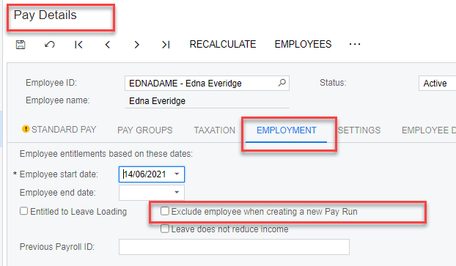
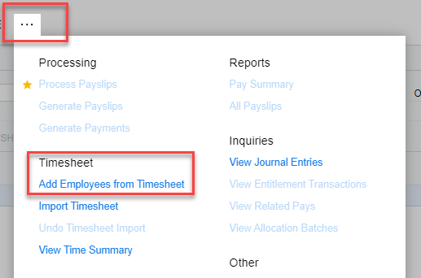
STREAMLINE PAY RUNS: FOR CASUAL EMPLOYEES AND EMPLOYEES USING TIME SHEETS.
Exclude employees from a new pay run
Prevent employees from being automatically added to new pay runs by selecting the Exclude employee when creating a new Pay Run checkbox on the Employment tab of the Pay Details form.
Add employees from a timesheet is available in the Pay Run – More menu ...
Disclaimer: The information presented is generic in nature and may not refer to an individual’s specific requirements.
If you have specific queries, please contact Acacia Consulting Services to speak with a certified Advanced consultant.
Notes:
Companies with lots of casual employees might find this especially useful.
For example, if you select this checkbox for all your casual employees, you could create an empty pay run, then add only the employees with timesheets to it.
If you choose to exclude employees from a new pay run, you can quickly add the employees who will need to be paid by clicking Add Employees from Timesheet.
This doesn’t add the timesheets, just any employees who are not already in the pay run that have records created in the imported timesheet batch within the current pay period dates.

Slide 9
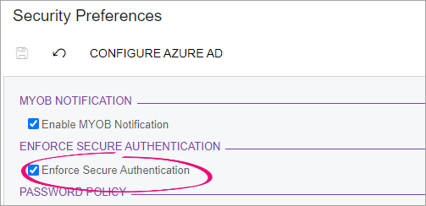
2FA: MANDATORY TRANSITION TO 2FA AUTHENTICATION
To strengthen the enforcement of secure authentication
Replacement of the Enforcement Date field on the Security Preferences screen (SM201060) with an Enforce Secure Authentication checkbox.
This helps ensure that users are always using secure authentication methods to access MYOB Advanced.
Disclaimer: The information presented is generic in nature and may not refer to an individual’s specific requirements.
If you have specific queries, please contact Acacia Consulting Services to speak with a certified Advanced consultant.
Notes:
This helps ensure that users are always using secure authentication methods to access MYOB Advanced.
It also stops users from bypassing secure authentication by closing the banner or sign-up window.

Slide 10
LOG ON: SINGLE SIGN ON WITH ms AZURE ACTIVE DIRECTORY
By integrating MYOB Advanced with Microsoft Azure Active Directory (Azure AD)
You can provide single sign-on (SSO) and manage users and access in one place.
Map Azure AD groups with user roles in Advanced to determine users’ access rights.
On the Security Preferences form (SM201060) Clicking Configure Azure AD.
For detailed steps
(for your IT gurus)
on setting up Azure AD,
see our online help pages.
Current issue preventing sites using Azure AD from completing Pay Runs – conflict around the two factor security Azure/MYOB.
Disclaimer: The information presented is generic in nature and may not refer to an individual’s specific requirements.
If you have specific queries, please contact Acacia Consulting Services to speak with a certified Advanced consultant.
Notes:
By integrating MYOB Advanced with Microsoft Azure Active Directory (Azure AD)
This lets you create, delete, and manage user accounts by using Azure AD.
During integration, you map Azure AD groups with user roles in MYOB Advanced to determine users’ access rights.
You are likely to need the help of your IT Department – who manage you Office 365 services
Details steps are available from the MYOB Adv Help centre
https://help.myob.com/wiki/display/GEN/Integrating+MYOB+Advanced+with+Microsoft+Azure+Active+Directory

Slide 11
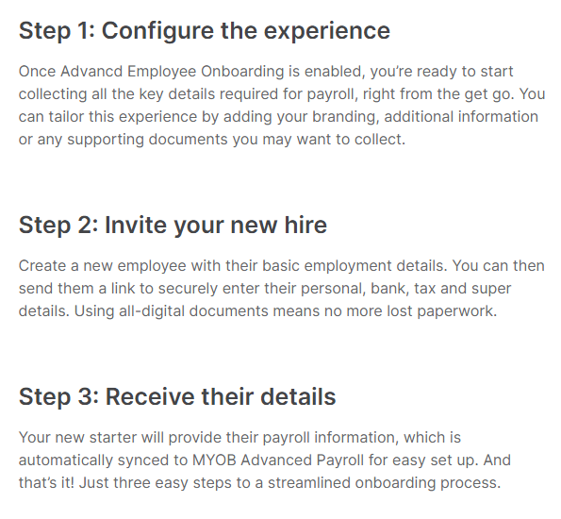
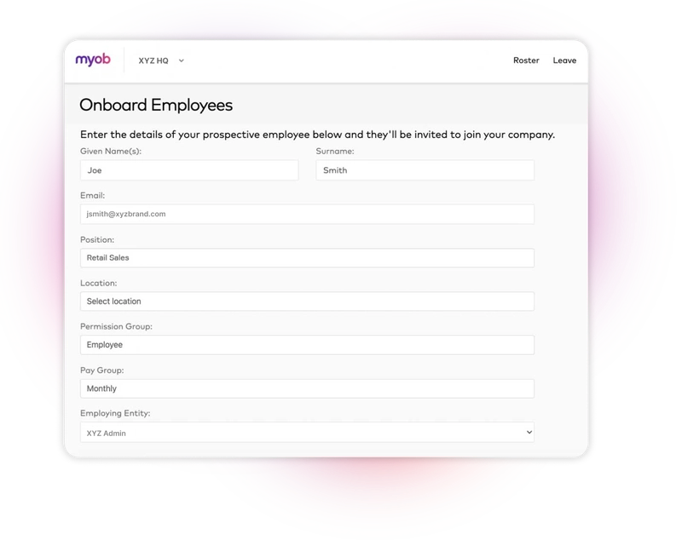
NEW MODULE: EMPLOYEE ONBOARDING
Due for release in June 2023:
Please contact us to register your interest to implement toward the end of July and onwards.
Disclaimer: The information presented is generic in nature and may not refer to an individual’s specific requirements.
If you have specific queries, please contact Acacia Consulting Services to speak with a certified Advanced consultant.

Slide 12
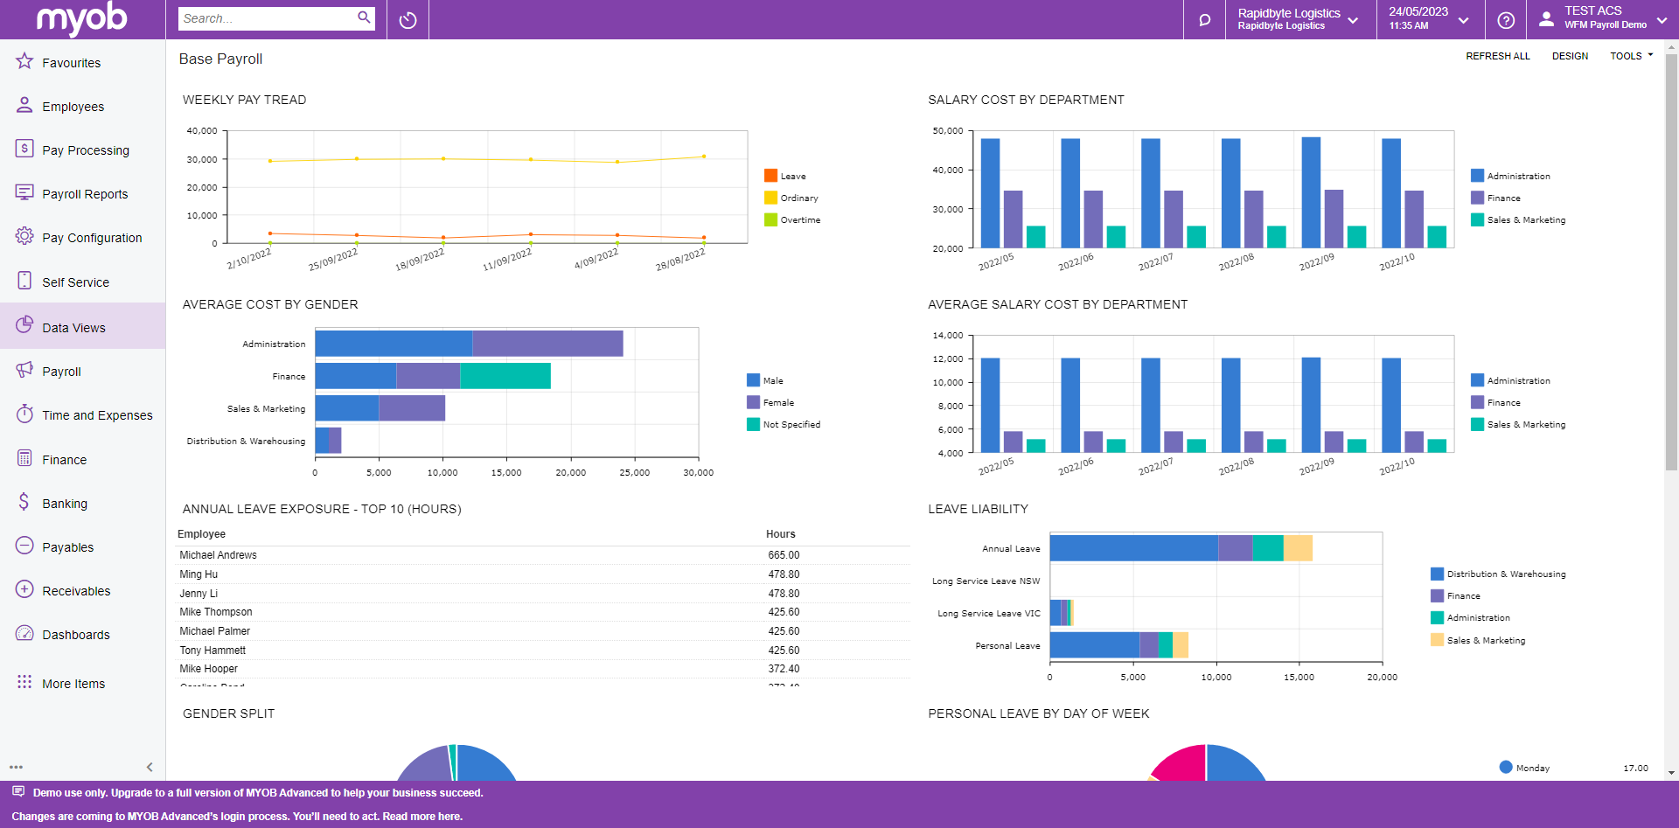
PAYROLL DASHBOARDS:
Reminder that we have Payroll Dashboards available
Acacia have a library of Dashboards based on
General Inquiries and Reports
Please talk to us about your requirements
Disclaimer: The information presented is generic in nature and may not refer to an individual’s specific requirements.
If you have specific queries, please contact Acacia Consulting Services to speak with a certified Advanced consultant.
Notes:
Reminder we have Dash vailable in Payroll

Slide 13
Q&a
OVER TO YOU

Slide 14
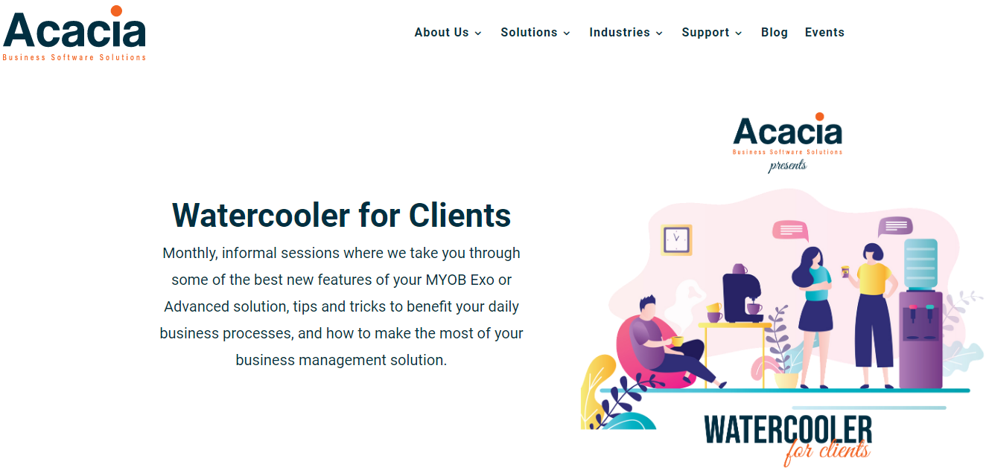
THANK YOU FOR JOINING US
Recording – Slides and Notes available from ACACIA WWW
Next ADVANCED water cooler: SEPT 2023
PLEASE SEND IDEAS TO HELPDESK@ACACIACS.COM.AU
Notes:
Remember to let other MYOB Advanced users know about Acacia Client Water Coolers.
We will be giving brief over views of new features in Payroll
But we welcome any suggest for other topics to cover

Slide 15
THANK YOU FOR JOINING US
Next Event for PAYROLL: - END of YEAR - 14th JUNE 2023
See our EVENTS PAGE on ACACIA WWW
Notes:
Remember to let other MYOB Advanced users know about Acacia Client Water Coolers.
We will be giving brief over views of new features in Payroll
But we welcome any suggest for other topics to cover

