Slide 1
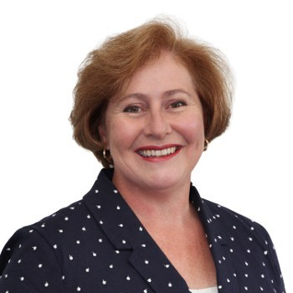
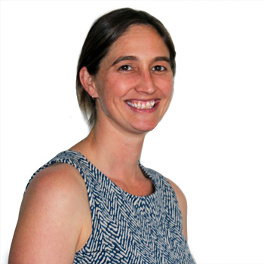
February 2023
Myob exo BUSINESS
VERSION 2022.3
new features
DIANNE SEMMENS
TONYA SEY
Managing Director
MYOB Exo & Advanced
Senior Consultant
MYOB Exo & Advanced
Notes:
Di to do introduction

Slide 2
EXO BUSINESS 2022 NEW FEATURES
Ability to specify CC and BCC email addresses when emailing debtor invoices
Introduction of Search Templates to Job Costing and CRM
Update to TPAR Submissions to comply with ATO's updated requirements
Ability to customise right-click MENU options on debtor and creditor transactions by user profile
Enhancements to business alerts for firing on new accounts and transactions

Slide 3
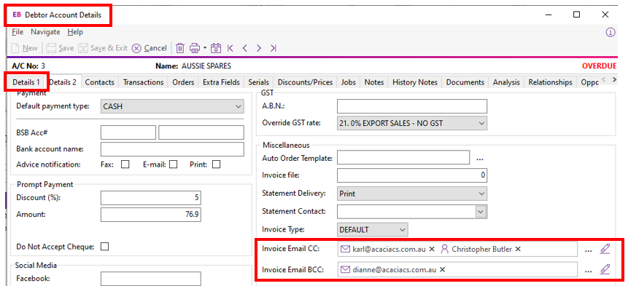
Ability to specify CC and BCC email addresses when emailing debtor invoices
Disclaimer: The information presented is generic in nature and may not refer to an individual’s specific requirements.
If you have specific queries, please contact Acacia Consulting Services to speak with a certified Exo consultant.
Notes:
Open debtor AUSSIE SPARES
Go to DETAILS 2 tab
Show CC & BCC emails
Show Contacts tab and point out CHRIS BUTLER
Type in CHRIS in the CC field and it will pick up the contact.
Demonstrate emailing the invoice
Note:
Dynamic email addresses (eg @INVOICE_CONTACT) only work with single emails, not mailshot. Otherwise CC & BCC work with mailshot

Slide 4
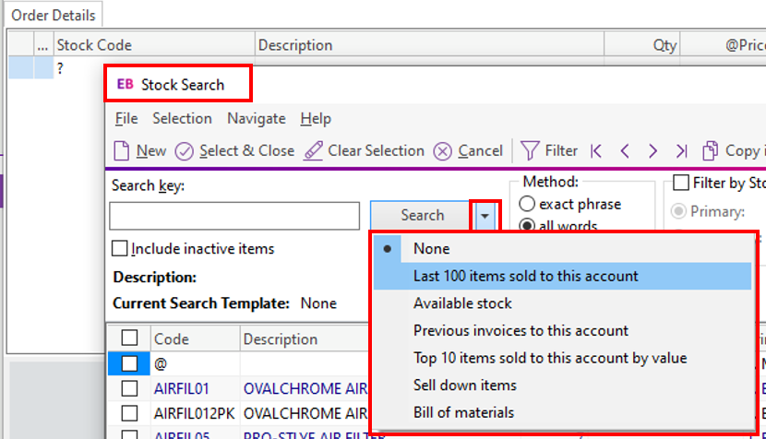
Search templates
Disclaimer: The information presented is generic in nature and may not refer to an individual’s specific requirements.
If you have specific queries, please contact Acacia Consulting Services to speak with a certified Exo consultant.
Notes:
Open job costing
Open any job
Click on Quote/Budget tab
Search for stock item and click on drop-down next to search
Open Exo Config and show availability tab for search templates.

Slide 5
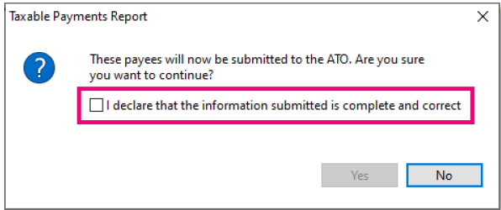
TPAR SUBMISSION
(TAXABLE PAYMENTS ANNUAL REPORT)
EXO VERSION 2022 MEETS THE UPDATED AUSTRALIAN TAXATION OFFICE REQUIREMENTS FOR TPAR REPORTING
https://www.ato.gov.au/business/reports-and-returns/taxable-payments-annual-report/
Disclaimer: The information presented is generic in nature and may not refer to an individual’s specific requirements.
If you have specific queries, please contact Acacia Consulting Services to speak with a certified Exo consultant.

Slide 6
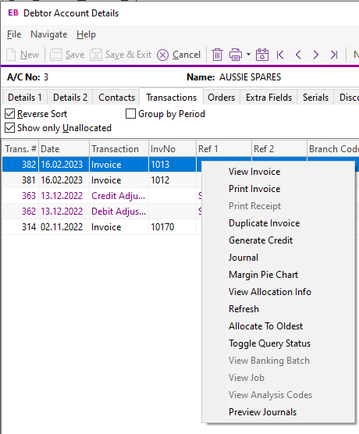
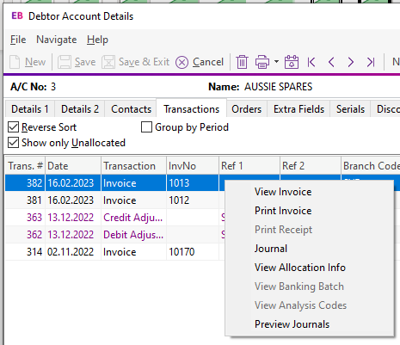
CUSTOMISE THE RIGHT CLICK!!!!
Disclaimer: The information presented is generic in nature and may not refer to an individual’s specific requirements.
If you have specific queries, please contact Acacia Consulting Services to speak with a certified Exo consultant.
Notes:
Open debtor AUSSIE SPARES
Right mouse click on an invoice show options
Log in as crm (password: crm)
Open debtor AUSSIE SPARES
Right mouse click on an invoice show options
Show Exo Config option

Slide 7
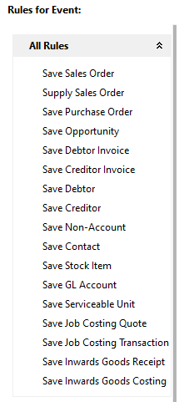
IMPROVEMENTS TO BUSINESS ALERTS
Disclaimer: The information presented is generic in nature and may not refer to an individual’s specific requirements.
If you have specific queries, please contact Acacia Consulting Services to speak with a certified Exo consultant.
Notes:
Create a new creditor account
Enter only name
----------
Business alerts can be warnings, can block, can send emails to relevant parties (internal/external). Can include links to Exo documents (ie open SO/PO)

Slide 8
Q&a
OVER TO YOU
Notes:
Di to do introduction

Slide 9
THANK YOU FOR JOINING US
Next water cooler: April
SEND THROUGH YOUR TOPIC IDEAS
PLEASE SEND IDEAS TO HELPDESK@ACACIACS.COM.AU
Notes:
Di to do introduction

